Slide 1
Why Deep?
Notes:
Actually for every machine learning
Three things: model, cost, learning

Slide 2
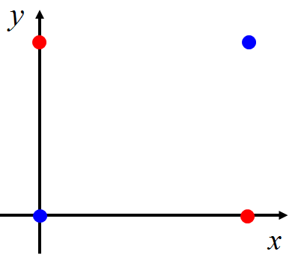


Limitation of Logistic Regression
$$(z≥0)$$
$$(z<0)$$
Can we?
Input Feature |  | Label
x₁ | x₂
0 | 0 | Class 2
0 | 1 | Class 1
1 | 0 | Class 1
1 | 1 | Class 2
z ≥ 0
z < 0
z < 0
z ≥ 0
Notes:
The preceding example employed typical “opportunistic,” or found, data. But even data generated by a designed experiment need external information. A DoD project from the early days of neural networks attempted to distinguish aerial images of forests with and without tanks in them. Perfect performance was achieved on the training set, and then on an outof-sample set of data that had been gathered at the same time but not used for training. This was celebrated but, wisely, a confirming study was performed. New images were collected on which the models performed extremely poorly. This drove investigation into the features driving the models and revealed them to be magnitude readings from specific locations of the images; i.e., background pixels. It turns out that the day the tanks had been photographed was sunny, and that for nontanks, cloudy!11 Even resampling the original data wouldn’t have protected against this error, as the flaw was inherent in the generating experiment.
PBS featured this project in a 1991 documentary series The Machine That Changed the World: Episode IV, “The Thinking Machine.”

Slide 3











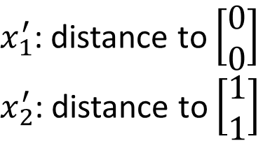
Limitation of Logistic Regression
$x_{1}^{′}$: distance to $\left[\begin{aligned}0 \\ 0\end{aligned}\right]$
$x_{2}^{′}$: distance to $\left[\begin{aligned}1 \\ 1\end{aligned}\right]$
Feature transformation
$$\left[\begin{aligned}x_{1} \\ x_{2}\end{aligned}\right]$$
$$\left[\begin{aligned}x_{1}^{′} \\ x_{2}^{′}\end{aligned}\right]$$
Not always easy ….. domain knowledge can be helpful
$$x_{2}^{′}$$
$$\left[\begin{aligned}0 \\ \sqrt{2}\end{aligned}\right]$$
$$\left[\begin{aligned}0 \\ 1\end{aligned}\right]$$
$$\left[\begin{aligned}1 \\ 1\end{aligned}\right]$$
$$\left[\begin{aligned}0 \\ 0\end{aligned}\right]$$
$$\left[\begin{aligned}0 \\ 1\end{aligned}\right]$$
$$\left[\begin{aligned}1 \\ 1\end{aligned}\right]$$
$$\left[\begin{aligned}\sqrt{2} \\ 0\end{aligned}\right]$$
$$x_{1}^{′}$$

Slide 4


Limitation of Logistic Regression
Cascading logistic regression models
$$x_{1}^{′}$$
$$x_{2}^{′}$$
Feature Transformation
Classification
(ignore bias in this figure)

Slide 5
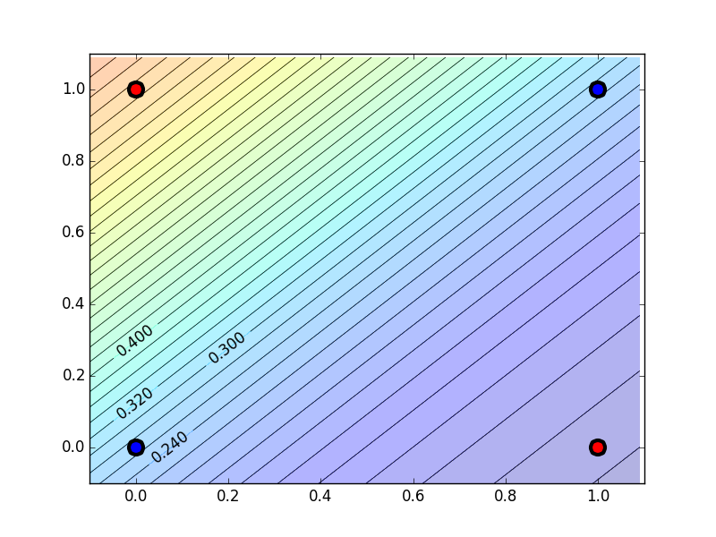
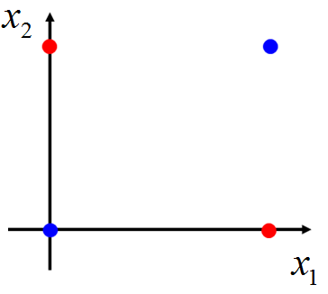
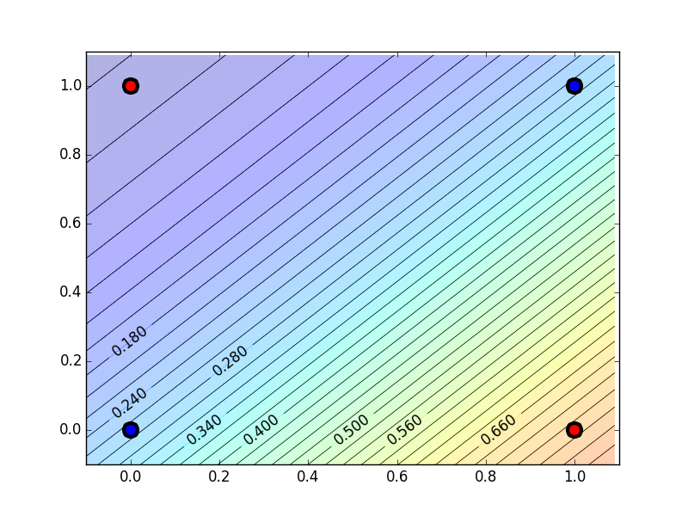
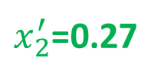
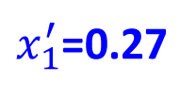
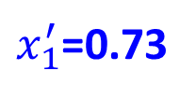
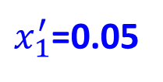
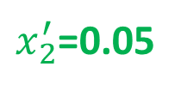




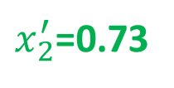
$x_{1}^{′}$=0.73
$x_{1}^{′}$=0.27
-1
-2
$$x_{1}^{′}$$
$x_{1}^{′}$=0.27
$x_{1}^{′}$=0.05
2
2
$x_{2}^{′}$=0.05
$x_{2}^{′}$=0.27
-2
$$x_{2}^{′}$$
-1
$x_{2}^{′}$=0.27
$x_{2}^{′}$=0.73
Notes:
1,-1,-3

Slide 6
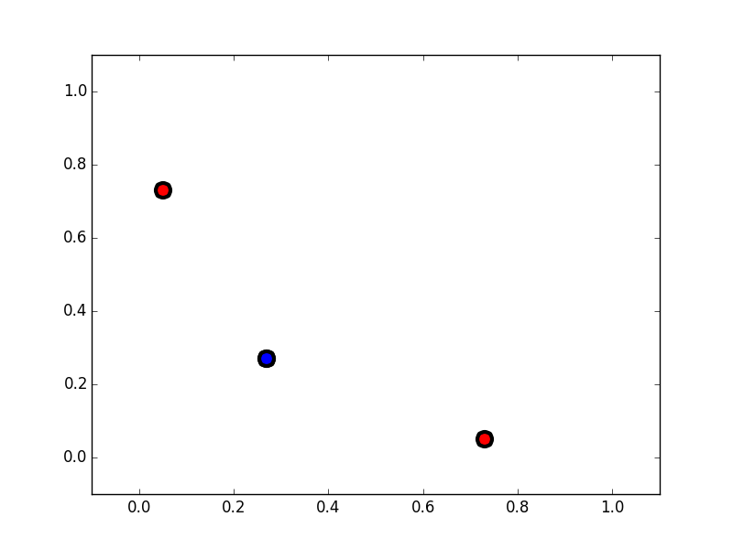


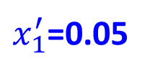


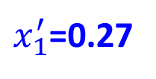





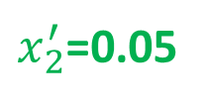
$x_{1}^{′}$=0.73
$x_{1}^{′}$=0.27
$$x_{1}^{′}$$
$x_{1}^{′}$=0.27
$x_{1}^{′}$=0.05
$$x_{2}^{′}$$
$x_{2}^{′}$=0.05
$x_{2}^{′}$=0.27
(0.73, 0.05)
$$x_{2}^{′}$$
(0.27, 0.27)
(0.05,0.73)
$x_{2}^{′}$=0.27
$x_{2}^{′}$=0.73
$$x_{1}^{′}$$

Slide 7
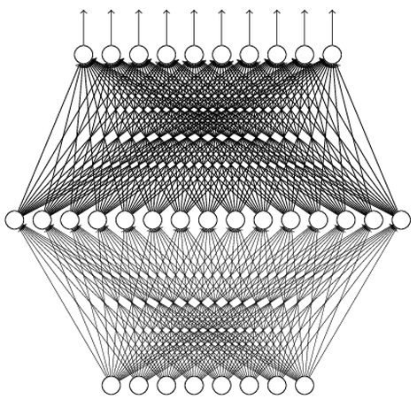
Why Deep? Universality Theorem
Any continuous function f
Can be realized by a network with one hidden layer
(given enough hidden neurons)
Reference for the reason: http://neuralnetworksanddeeplearning.com/chap4.html
Why “Deep” neural network not “Fat” neural network?

Slide 8
Deeper is Better?
Layer X Size | Word Error Rate (%) | Layer X Size | Word Error Rate (%)
1 X 2k | 24.2
2 X 2k | 20.4
3 X 2k | 18.4
4 X 2k | 17.8
5 X 2k | 17.2 | 1 X 3772 | 22.5
7 X 2k | 17.1 | 1 X 4634 | 22.6
 |  | 1 X 16k | 22.1
Not surprised, more parameters, better performance
Seide, Frank, Gang Li, and Dong Yu. "Conversational Speech Transcription Using Context-Dependent Deep Neural Networks." Interspeech. 2011.
Notes:
SWB
For a fixed number of parameters, a deep model is clearly better than the shallow one.

Slide 9
Fat + Short v.s. Thin + Tall
The same number of parameters
Which one is better?
……
……
……
Shallow
Deep

Slide 10
Fat + Short v.s. Thin + Tall
Layer X Size | Word Error Rate (%) | Layer X Size | Word Error Rate (%)
1 X 2k | 24.2
2 X 2k | 20.4
3 X 2k | 18.4
4 X 2k | 17.8
5 X 2k | 17.2 | 1 X 3772 | 22.5
7 X 2k | 17.1 | 1 X 4634 | 22.6
 |  | 1 X 16k | 22.1
Why?
Seide, Frank, Gang Li, and Dong Yu. "Conversational Speech Transcription Using Context-Dependent Deep Neural Networks." Interspeech. 2011.

Slide 11
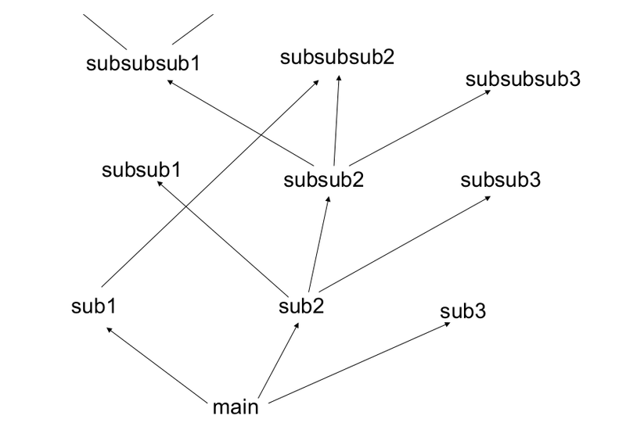
Modularization
Deep → Modularization
Don’t put everything in your main function.
http://rinuboney.github.io/2015/10/18/theoretical-motivations-deep-learning.html

Slide 12
Modularization
Deep → Modularization
Classifier 1
Girls with
long hair
長髮女
長髮女
長髮女
長髮女
Classifier 2
Boys with
long hair
長髮男
Image
weak
Little examples
Classifier 3
Girls with
short hair
短髮女
短髮女
短髮女
短髮女
Classifier 4
Boys with short hair
短髮男
短髮男
短髮男
短髮男
Notes:
Programming -> all in main -> so long and bad
-> function -> shorter

Slide 13
Modularization
Each basic classifier can have sufficient training examples.
Deep → Modularization
長髮女
長髮男
長髮女
Boy or Girl?
短髮女
長髮女
短髮女
長髮女
短髮女
v.s.
短髮男
短髮女
短髮男
Image
短髮男
短髮男
Basic
Classifier
長髮女
短髮女
Long or short?
長髮女
短髮女
長髮女
短髮女
長髮女
短髮女
v.s.
短髮男
長髮男
短髮男
Classifiers for the attributes
短髮男
短髮男

Slide 14
Modularization
can be trained by little data
Deep → Modularization
Classifier 1
Girls with
long hair
Boy or Girl?
Classifier 2
Boys with
long hair
Image
Basic
Classifier
fine
Little data
Classifier 3
Girls with
short hair
Long or short?
Classifier 4
Boys with short hair
Sharing by the following classifiers as module

Slide 15
Modularization
→ Less training data?
Deep → Modularization
……
The modularization is automatically learned from data.
……
……
……
……
……
……
The most basic classifiers
Use 1st layer as module to build classifiers
Use 2nd layer as module ……
Notes:
Poepel said AI＝ ｄｅｅｐ ＋ ｂｉｇｄａｔａ
Bigdata -> deep
Deep is not for big data
Deep Learning also works on small data set.
Need less data!!!!!

Slide 16









Modularization - Image
Deep → Modularization
……
……
……
……
……
……
……
The most basic classifiers
Use 1st layer as module to build classifiers
Use 2nd layer as module ……
Reference: Zeiler, M. D., & Fergus, R. (2014). Visualizing and understanding convolutional networks. In Computer Vision–ECCV 2014 (pp. 818-833)
Notes:
Less training data

Slide 17
Modularization - Speech
The hierarchical structure of human languages
what do you think
Phoneme:
hh w aa t d uw y uw th ih ng k
Tri-phone:
…… t-d+uw d-uw+y uw-y+uw y-uw+th ……
t-d+uw1 t-d+uw2 t-d+uw3
d-uw+y1 d-uw+y2 d-uw+y3
State:

Slide 18


Modularization - Speech
The first stage of speech recognition
Classification: input $→$ acoustic feature, output $→$ state
Determine the state each acoustic feature belongs to
……
Acoustic feature
States:
a
a
a
b
b
c
c
Notes:
Mel-scale Frequency Cepstral Coefficients

Slide 19

Modularization - Speech
Each state has a stationary distribution for acoustic features
Gaussian Mixture Model (GMM)
t-d+uw1
P(x|”t-d+uw1”)
d-uw+y3
P(x|”d-uw+y3”)

Slide 20
Modularization - Speech
Each state has a stationary distribution for acoustic features
Tied-state
pointer
pointer
P(x|”d-uw+y3”)
P(x|”y-uw+th3”)
Same Address

Slide 21
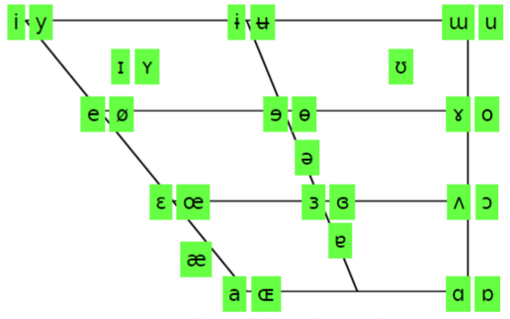
Modularization - Speech
In HMM-GMM, all the phonemes are modeled independently
Not an effective way to model human voice
front
back
high
The sound of vowel is only controlled by a few factors.
low
http://www.ipachart.com/
Notes:
http://www.danielpovey.com/files/icassp10_multiling.pdf
The vertical axis of the chart is mapped by vowel height. Vowels pronounced with the tongue lowered are at the bottom, and vowels pronounced with the tongue raised are at the top. For example, [ɑ] (the first vowel in father) is at the bottom because the tongue is lowered in this position. However, [i] (the vowel in "meet") is at the top because the sound is said with the tongue raised to the roof of the mouth.
In a similar fashion, the horizontal axis of the chart is determined by vowel backness. Vowels with the tongue moved towards the front of the mouth (such as [ɛ], the vowel in "met") are to the left in the chart, while those in which it is moved to the back (such as [ʌ], the vowel in "but") are placed to the right in the chart.
In places where vowels are paired, the right represents a rounded vowel (in which the lips are rounded) while the left is its unrounded counterpart.

Slide 22
Modularization - Speech
DNN input:
One acoustic feature
P(a|x_{i})
P(b|x_{i})
P(c|x_{i})
……
DNN output:
……
Probability of each state
Size of output layer
= No. of states
All the states use the same DNN
DNN
……
……
x_{i}
Notes:
senones (tied triphone
states)
RNN may be preferred, but it still can not address the problem
Dynamics should be considered
Three ways to doing that

Slide 23
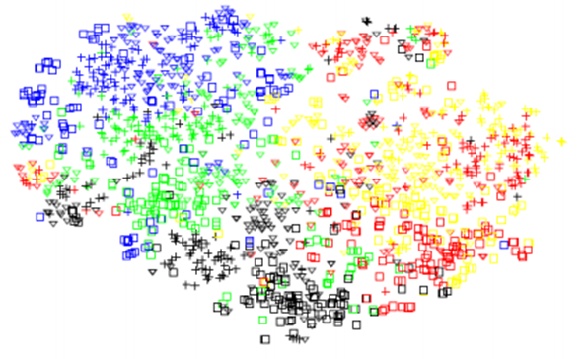
front
back
Modularization
high
Vu, Ngoc Thang, Jochen Weiner, and Tanja Schultz. "Investigating the Learning Effect of Multilingual Bottle-Neck Features for ASR." Interspeech. 2014.
Output of hidden layer reduce to two dimensions
low
/i/
/u/
The lower layers detect the manner of articulation
All the phonemes share the results from the same set of detectors.
/e/
/o/
/a/
Use parameters effectively
Notes:
http://www.ipachart.com/
http://csl.anthropomatik.kit.edu/downloads/354_Paper.pdf
143-1500-42-1500-152
This is BN acturally
a rounded vowel, the lips form a circular opening

Slide 24
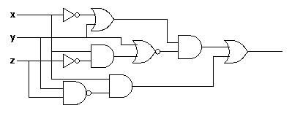
Analogy
Logic circuits
Neural network
Logic circuits consists of gates
A two layers of logic gates can represent any Boolean function.
Using multiple layers of logic gates to build some functions are much simpler
Neural network consists of neurons
A hidden layer network can represent any continuous function.
Using multiple layers of neurons to represent some functions are much simpler
less parameters
less data?
less gates needed
This page is for EE background.

Slide 25
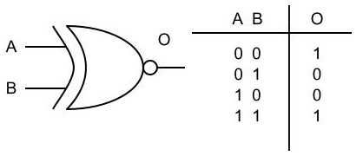
Analogy
E.g. parity check
Circuit
For input sequence with d bits,
1 0 1 0
1 (even)
Circuit
Two-layer circuit need O(2^{d}) gates.
0 0 0 1
0 (odd)
XNOR
1
0
0
1
0
1
0
With multiple layers, we need only O(d) gates.
Notes:
Any Boolean function can be written as a sum of products (disjunctive normal form: AND gates on the first layer with optional negation of inputs, and OR gate on the second layer) or a product of sums (conjunctive normal form: OR gates on the first layer with optional negation of inputs, and AND gate on the second layer).
同位元檢查(Parity Check)
00 1
01 0
10 0
11 1

Slide 26

More Analogy

Slide 27

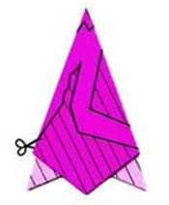
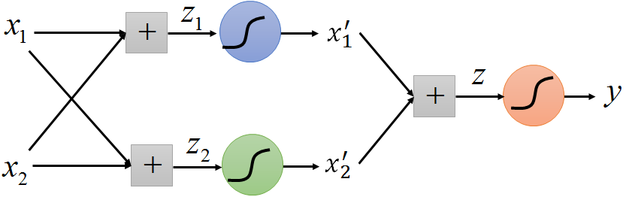
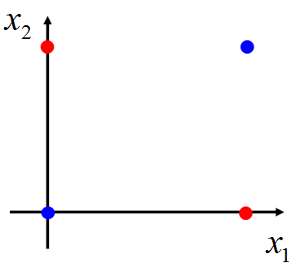
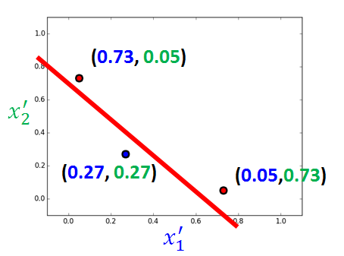
More Analogy
Use data effectively
Folding the space

Slide 28
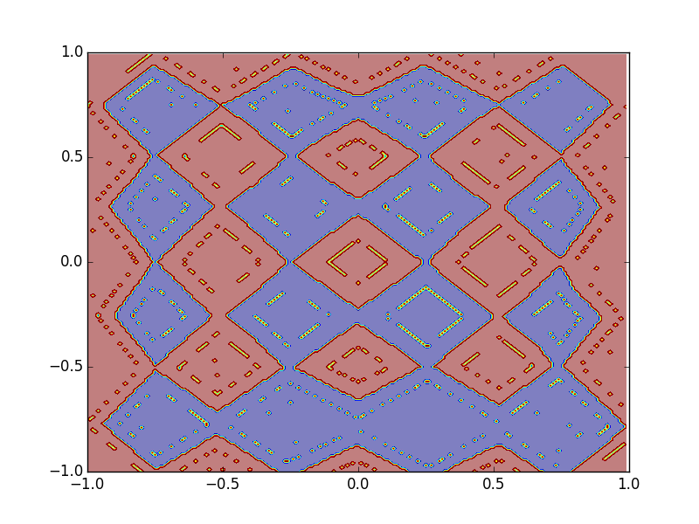
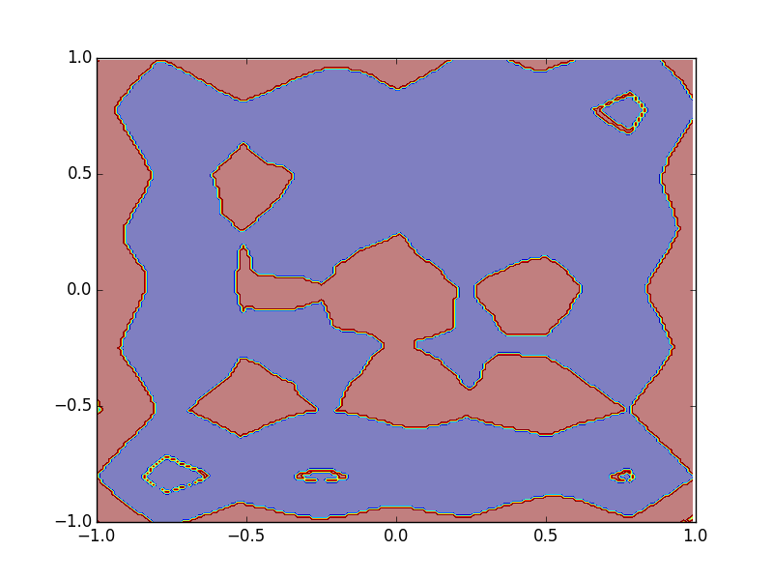
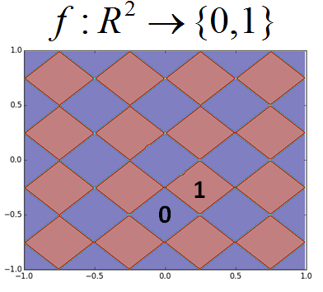
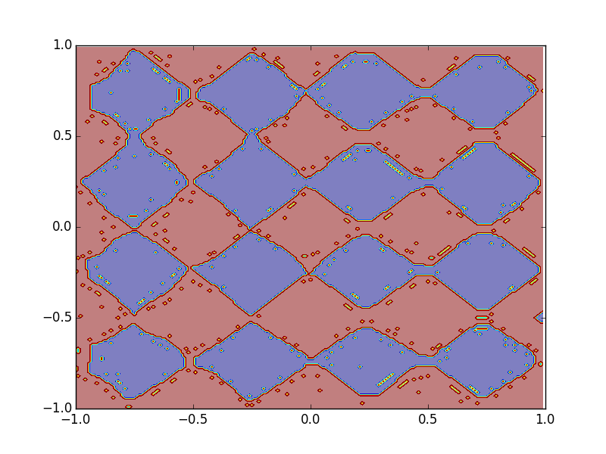
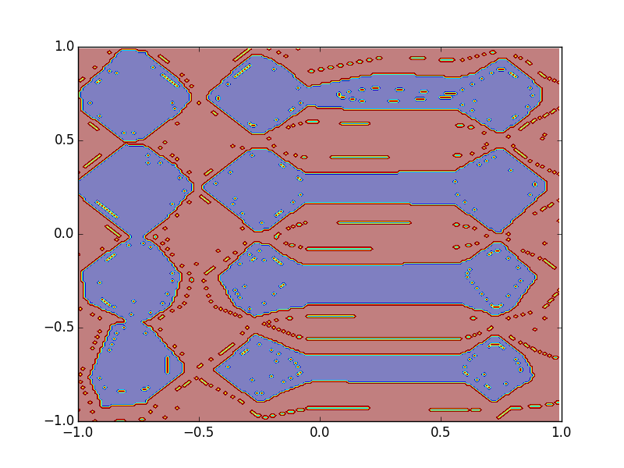
More Analogy - Experiment
Different numbers of training examples
10,0000
2,0000
1 hidden
layer
3 hidden
layers

Slide 29
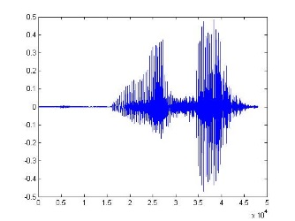
End-to-end Learning
Model
Production line
Hypothesis Functions
Simple
Function 1
Simple
Function 2
Simple
Function N
……
“Hello”
A very complex function
End-to-end training:
What each function should do is learned automatically
Notes:
It is hard to define deep learning.
生產線的概念

Slide 30
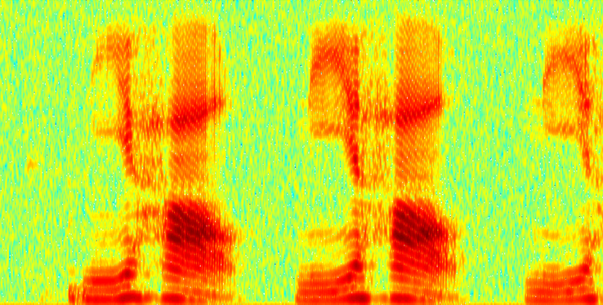
End-to-end Learning - Speech Recognition
Shallow Approach
DFT
Waveform
spectrogram
GMM
DCT
log
…
“Hello”
Filter bank
MFCC
Each box is a simple function in the production line:
:hand-crafted
:learned from data
Notes:
Each box is a simple function in product line

Slide 31
End-to-end Learning - Speech Recognition
Deep Learning
f₁
f₂
All functions are learned from data
f₃
f₅
f₄
“Hello”
Less engineering labor, but machine learns more
Notes:
Same as in image and text
MFCC: Mel-frequency cepstral coefficients

Slide 32
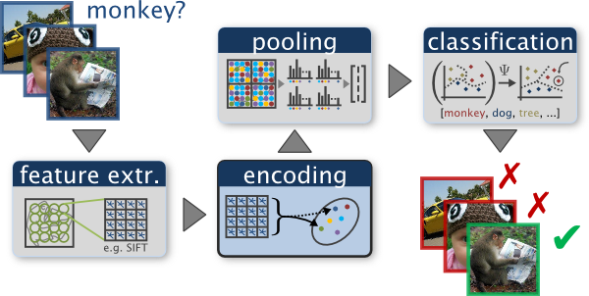
End-to-end Learning - Image Recognition
Shallow Approach
http://www.robots.ox.ac.uk/~vgg/research/encoding_eval/
:hand-crafted
:learned from data
Notes:
Scale Invariant Feature Transform

Slide 33

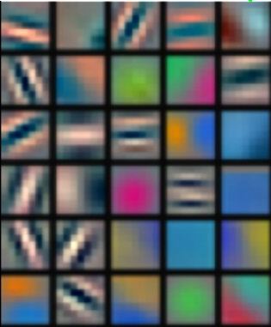
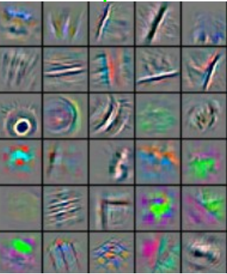
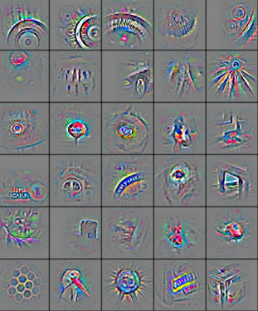
End-to-end Learning - Image Recognition
Reference: Zeiler, M. D., & Fergus, R. (2014). Visualizing and understanding convolutional networks. In Computer Vision–ECCV 2014 (pp. 818-833)
Deep Learning
All functions are learned from data
f₁
f₂
f₃
f₄
“monkey”

Slide 34
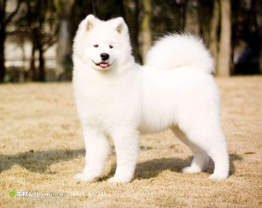
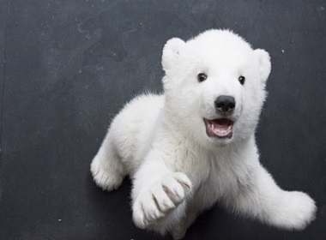
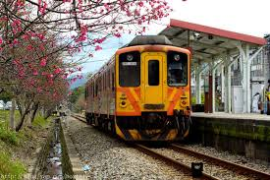
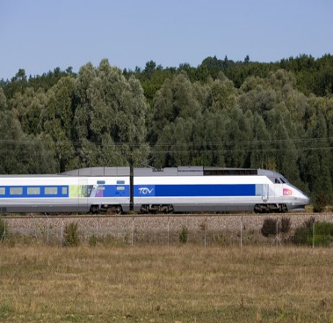
Complex Task …
Very similar input, different output
Very different input, similar output
System
dog
System
bear
System
train
System
train

Slide 35
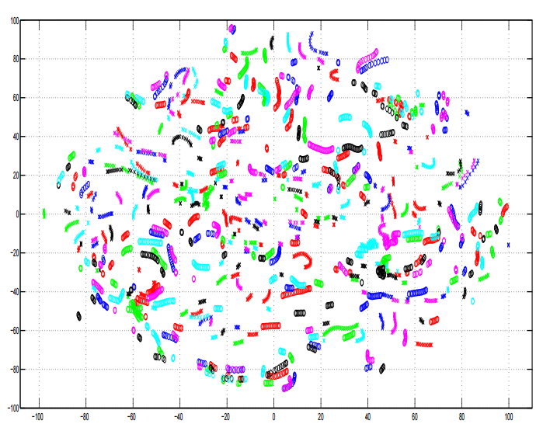
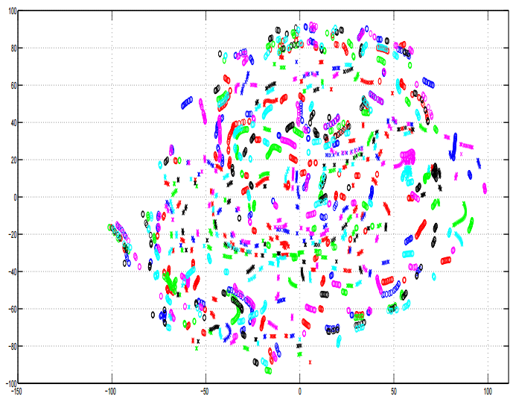
Complex Task …
A. Mohamed, G. Hinton, and G. Penn, “Understanding how Deep Belief Networks Perform Acoustic Modelling,” in ICASSP, 2012.
Speech recognition: Speaker normalization is automatically done in DNN
Input Acoustic Feature (MFCC)
1-st Hidden Layer
Notes:
] Lower later for speaker adp
. This fits with human speech recognition which appears to use many layers of feature extractors and event detectors [7].

Slide 36
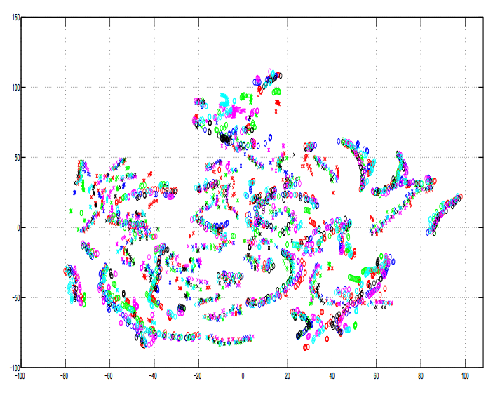
Complex Task …
A. Mohamed, G. Hinton, and G. Penn, “Understanding how Deep Belief Networks Perform Acoustic Modelling,” in ICASSP, 2012.
Speech recognition: Speaker normalization is automatically done in DNN
Input Acoustic Feature (MFCC)
8-th Hidden Layer
Notes:
] Lower later for speaker adp
. This fits with human speech recognition which appears to use many layers of feature extractors and event detectors [7].

Slide 37
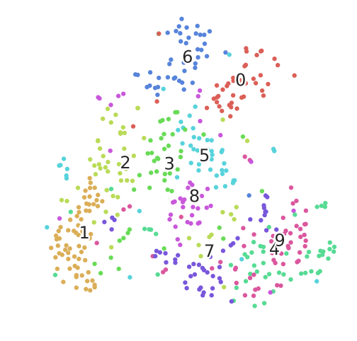
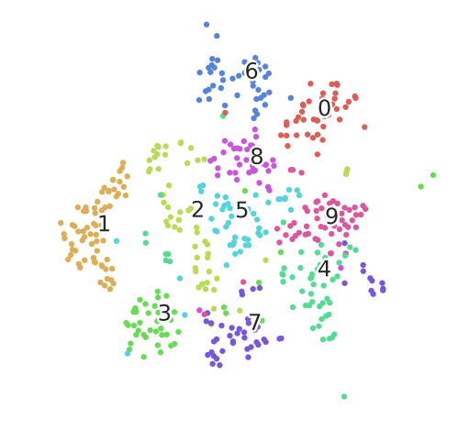
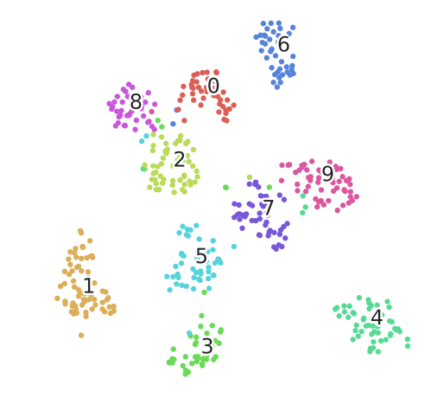
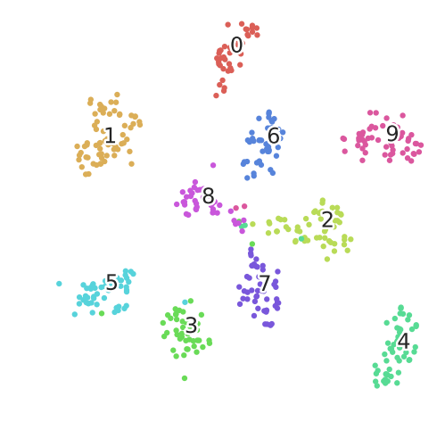
MNIST
input
1-st hidden
2-nd hidden
3-rd hidden

Slide 38
Brute-force Memorization ?
https://arxiv.org/pdf/1611.03530.pdf
Final of 2017 Spring: https://ntumlds.wordpress.com/2017/03/27/r05922018_drliao/
Notes:
Understanding deep learning requires rethinking generalization
https://medium.com/intuitionmachine/rethinking-generalization-in-deep-learning-ec66ed684ace
1. The effective capacity of neural networks is large enough for a brute-force memorization of the entire data set.
2. Even optimization on random labels remains easy. In fact, training time increases only by a small constant factor compared with training on the true labels.
3. Randomizing labels is solely a data transformation, leaving all other properties of the learning problem unchanged.
demo
https://xkcd.com/1838/
驗證留言
https://ntumlds.wordpress.com/2017/03/27/r05922018_drliao/

Slide 40

Knowledge Distillation
Knowledge Distillation
https://arxiv.org/pdf/1503.02531.pdf
Do Deep Nets Really Need to be Deep?
https://arxiv.org/pdf/1312.6184.pdf
Cross-entropy minimization
Learning target
“1”: 0.7, “7”: 0.2. “9”: 0.1
?
Teacher Net
(Deep)
Student Net
(Shallow)
Training
Data

Slide 41

https://arxiv.org/pdf/1312.6184.pdf

Slide 42


To learn more …
Do Deep Nets Really Need To Be Deep? (by Rich Caruana)
http://research.microsoft.com/apps/video/default.aspx?id=232373&r=1
keynote of Rich Caruana at ASRU 2015

